Slide 1
Chapter 7 FEATURE EXTRACTION AND SELECTION METHODS Part 3
Cios / Pedrycz / Swiniarski / Kurgan

Slide 2
Feature Selection
GOAL
find the “best” subset of features according to a predefined selection criterion
Reasons for Feature Selection (FS)
Features can be:
– irrelevant (have no effect on processing)
– redundant (the same, highly correlated)
Decrease problem dimensionality
The process of FS does NOT involve transformation of the original features.
© 2007 Cios / Pedrycz / Swiniarski / Kurgan
2

Slide 3
Feature Selection
Feature relevancy
can be understood as its ability to contribute to improving classifier’s performance
For Boolean features:
Def1:
A feature x_{i} is relevant to class c if it appears in every Boolean formula that represents c, otherwise it is irrelevant
© 2007 Cios / Pedrycz / Swiniarski / Kurgan
3

Slide 4
Feature Selection
© 2007 Cios / Pedrycz / Swiniarski / Kurgan
4

Slide 5
Feature Selection
AT
Weakly Relevant Features
Relevant Features
Strongly
Relevant
Features
Loosely based on: https://pubs.rsc.org/en/content/articlelanding/2017/mb/c7mb00115k

Slide 6
Feature Selection
Key feature selection methods:
- Open-loop (filter / front-end / preset bias)
- Closed-loop (wrapper / performance bias)
Result: data set with reduced # of features according to a chosen criterion
© 2007 Cios / Pedrycz / Swiniarski / Kurgan
6

Slide 7
Feature Selection
Open-loop methods (FILTER, preset bias, front end):
Select features for which the reduced data maximizes between-class separability; achieved by evaluating within-class and between-class covariance matrices;
no feedback mechanism.
Filter Method (generalized) From here
© 2007 Cios / Pedrycz / Swiniarski / Kurgan
7
Notes:
It’s a very linear approach

Slide 8
Feature Selection
An open loop feature selection method
© 2007 Cios / Pedrycz / Swiniarski / Kurgan
8

Slide 9
Feature Selection
Closed-loop methods (WRAPPER, performance bias, classifier feedback):
Select features based on the processing algorithm’s performance (feedback mechanism) that serves as a criterion for a feature subset selection.
WRAPPER Method (Generalized) From here
© 2007 Cios / Pedrycz / Swiniarski / Kurgan
9

Slide 10
Feature Selection
A closed-loop feature selection method
© 2007 Cios / Pedrycz / Swiniarski / Kurgan
10

Slide 11
Summary of differences
AT
The main differences between the filter and wrapper methods for feature selection are:
Filter methods measure the relevance of features by their correlation with dependent variable while wrapper methods measure the usefulness of a subset of feature by actually training a model on it.
Filter methods are much faster compared to wrapper methods as they do not involve training the models. On the other hand, wrapper methods are computationally very expensive as well.
Filter methods use statistical methods for evaluation of a subset of features while wrapper methods use cross validation.
Filter methods might fail to find the best subset of features in many occasions but wrapper methods can always provide the best subset of features.
Using the subset of features from the wrapper methods make the model more prone to overfitting as compared to using subset of features from the filter methods.
From: https://www.analyticsvidhya.com/blog/2016/12/introduction-to-feature-selection-methods-with-an-example-or-how-to-select-the-right-variables/

Slide 12
Feature Selection
Procedure for optimal FS:
Search procedure, used to search through candidate subsets of features
- FS criterion, J_{feature}, used to judge if one subset of features is better than another
Since feature selection methods are computationally intensive heuristic search methods are used; as a result only sub-optimal solutions can be obtained.
© 2007 Cios / Pedrycz / Swiniarski / Kurgan
12

Slide 13
Feature Selection
FS criteria
Used criteria are based on maximization approach: a better subset of features always gives a bigger value of a criterion and the optimal feature subset gives the maximum value of the criterion.
In practice:
For the limited data and FS criterion based on a classifier performance: removing feature(s) may improve algorithm’s performance up to a point but then starts to degrade – it is known as peaking phenomenon.
© 2007 Cios / Pedrycz / Swiniarski / Kurgan
13

Slide 14
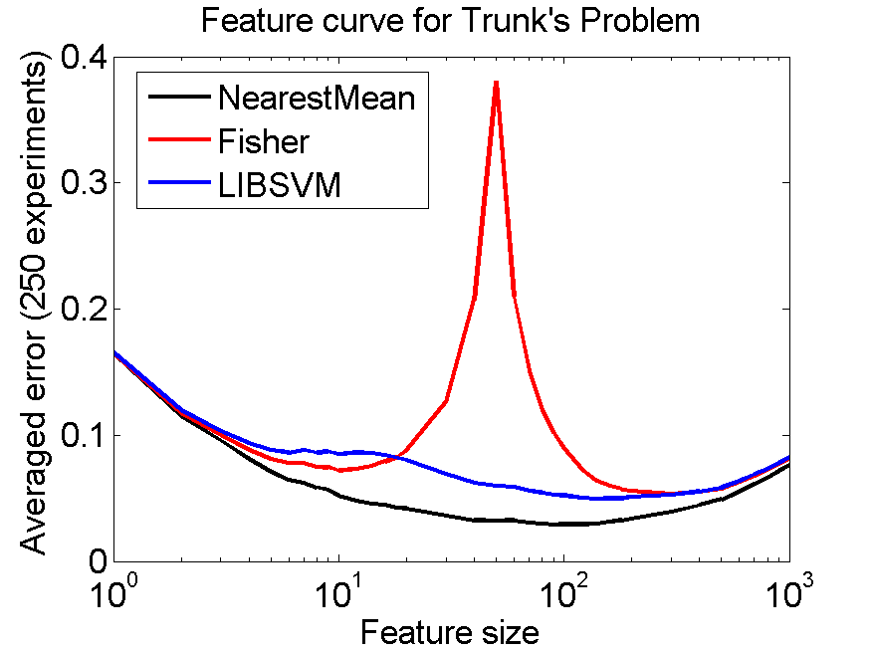
Feature Selection Peaking Phenomenon
AT
To learn more about the peaking Phenomenon, look to:
Trunk’s example -1979
Trunk’s example of the peaking phenomenon
http://37steps.com/2448/trunks-example/

Slide 15
Feature Selection
Paradigms of optimal FS: minimal representations
Occam’s Razor (stated by monk William of Ockham):
The simplest explanation of the observed phenomena in a given domain is the most likely to be a correct one.
Minimal Description Length (MDL) Principle:
Best feature selection is achieved by choosing a minimal feature subset that fully describes all classes in a given data set.
© 2007 Cios / Pedrycz / Swiniarski / Kurgan
15

Slide 16
Feature Selection
MDL Principle can be seen as a formalization of the Occam’s razor heuristic.
In other words: if a system can be defined in terms of input and the corresponding output data, then in the worst case (longest) it can be described by supplying the entire data set.
On the other hand, if regularities can be discovered, then a much shorter description is possible and can be measured by the MDL principle.
© 2007 Cios / Pedrycz / Swiniarski / Kurgan
16

Slide 17
Feature Selection
Criteria
A feature selection algorithm uses predefined feature selection criterion
(which measures goodness of the subset of features)
Our hope, via using the MDL principle, is that:
by reducing dimensionality we improve generalization
ability (up to some max value)
but we know that it will start to degrade at some point
of reduction.
© 2007 Cios / Pedrycz / Swiniarski / Kurgan
17

Slide 18
Feature Selection
OPEN-LOOP METHODS (OLM)
Feature selection criteria based on information contained in the data set alone, can be based on:
MDL Principle
Mutual Information
Inconsistency Count
Interclass Separability
© 2007 Cios / Pedrycz / Swiniarski / Kurgan
18

Slide 19
Feature Selection
OLM based on the MDL Principle
Choose a minimal feature subset that fully describes all classes in a given data set.
1. For all subsets do:
J_{feature}(subset_{i}) = 1 if subset_{i} satisfactorily describes all classes in the data
= 0 otherwise
2. Choose a minimal subset for which J_{feature}(subset_{i}) = 1
© 2007 Cios / Pedrycz / Swiniarski / Kurgan
19

Slide 20
Minimum Description Length Principle
If a system can be defined in terms of input and corresponding output data, then in the worst case (longest), it can be described by supplying the entire data set, thus constituting the longest (least compressed) model of the data.
However, if regularities can be discovered in the data, say, expressed in the form of production rules, then a much shorter description is possible, e.g., using a smal subset of features, and it can be measured by the MDL principle.
The MDL principle says that the complexity of a model/hypothesis is measured by the number of bits needed to encode the model itself, plus the number of bits needed to encode the data using the model.
© 2007 Cios / Pedrycz / Swiniarski / Kurgan
20

Slide 21
Minimum Description Length Principle
Formally, from a set of hypothesis, we choose as the “best” one that minimizes the following sum:
L(M) + L(D│M)
where L(M) is length in bits of description of the model, and L(D│M) is length of description of the data encoded using model M.
The basic idea behind this definition can be explained using notions of underfitting and overfitting.
It is easy to find a complex model, meaning one having large L(M) value that overfits the data (i.e., with small L(D│M) value).
It is equally easy to find a simple model, with the small L(M) value that underfits the data, but which has large L(D│M) value.
© 2007 Cios / Pedrycz / Swiniarski / Kurgan
21

Slide 22
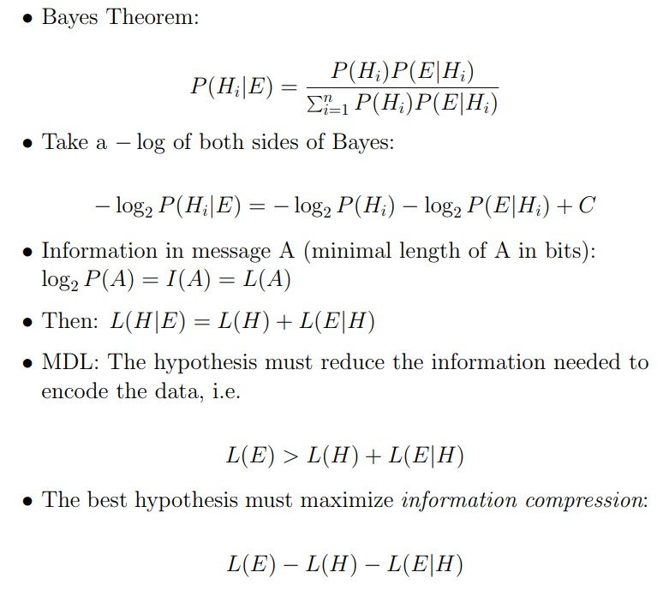
MDL Example
From http://www.cs.ccsu.edu/~markov/ccsu_courses/mdl.pdf
22

Slide 23
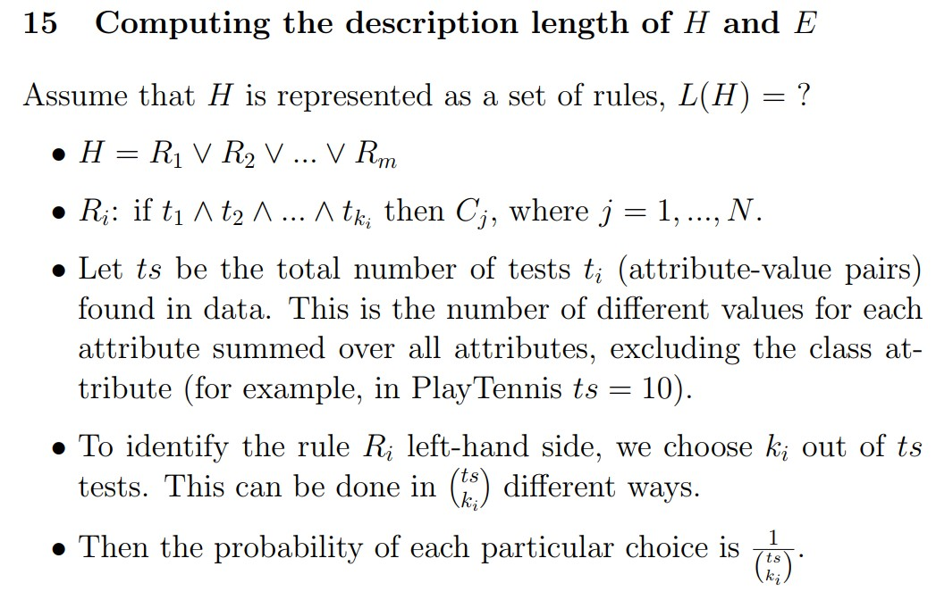
23

Slide 24
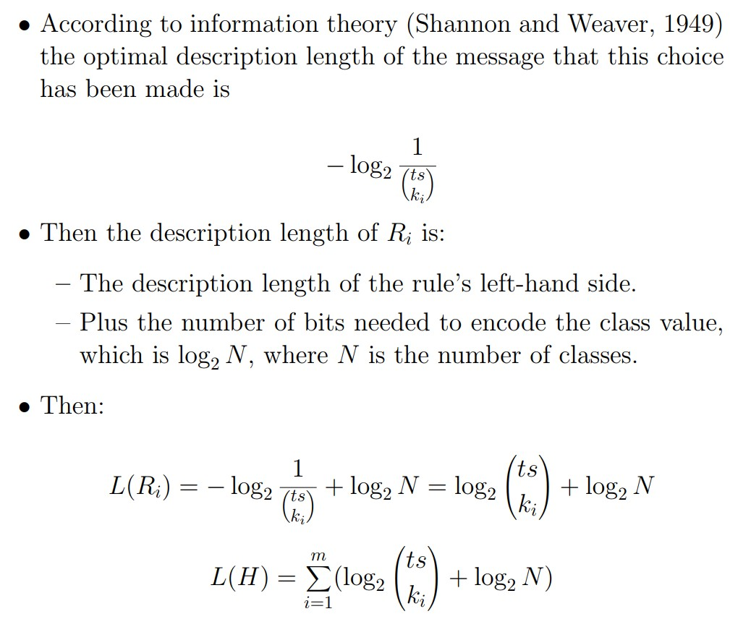
24

Slide 25
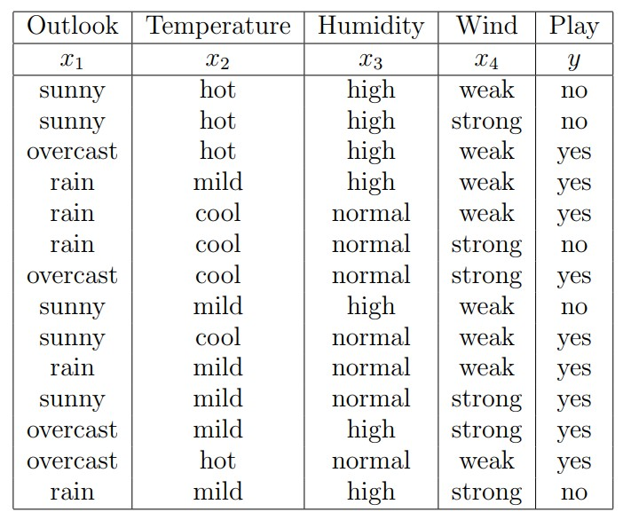
3
3
2
2
25

Slide 26
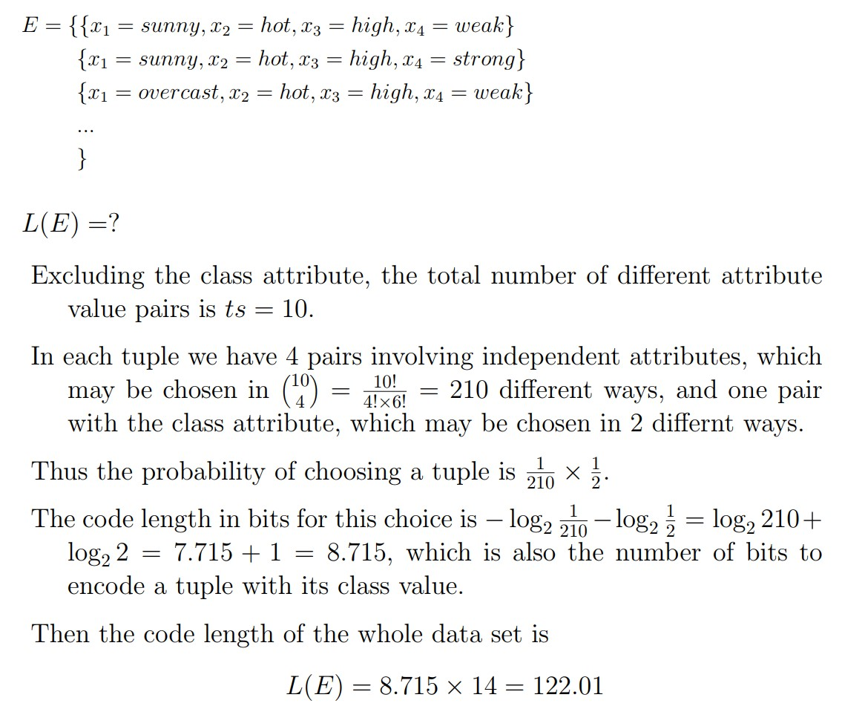
Each tuple can be represented as a set of attribute value pairs as follows:
26
Notes:
Factorial

Slide 28
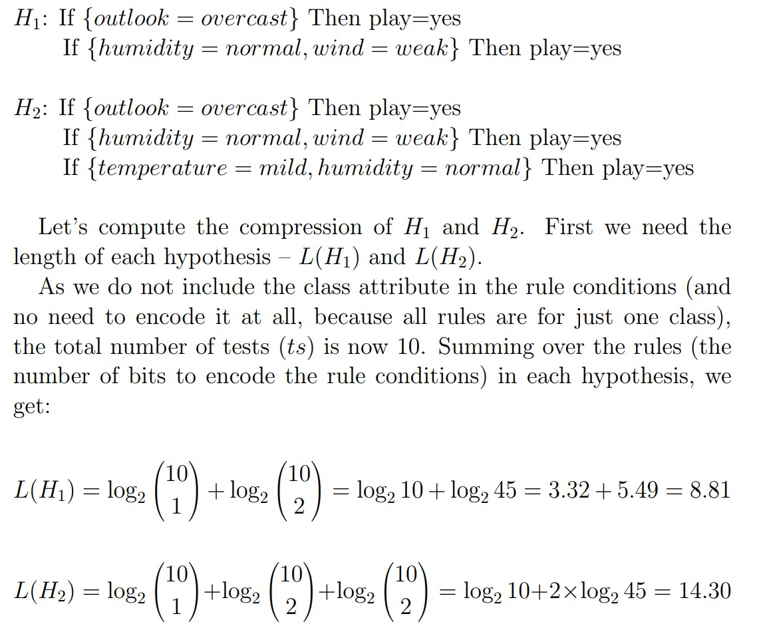
28

Slide 29
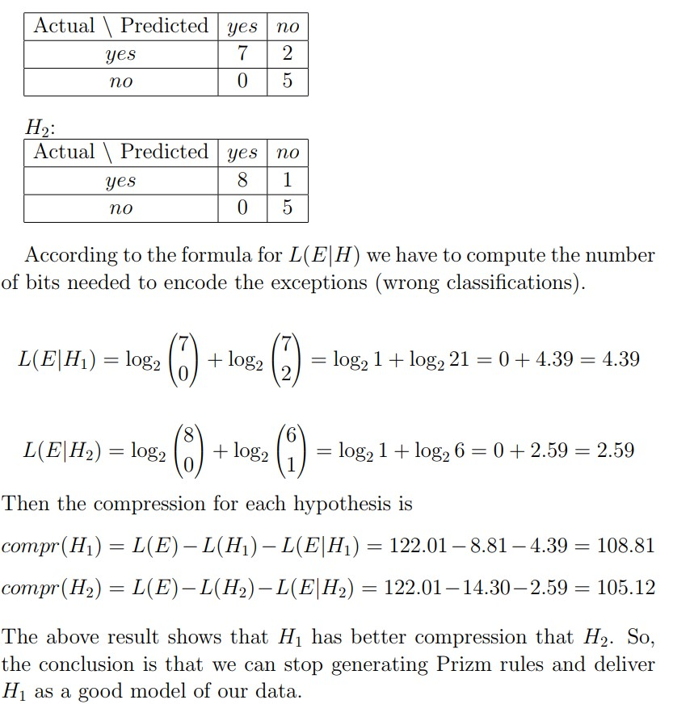
29

Slide 30
Feature Selection
OLM based on Mutual Information - a measure that uses entropy as a criterion for feature selection.
For discrete features:
Entropy
Conditional Entropy
Set_{X} – subset, c_{i} – class, l – number of classes
Criterion: J_{feature}(Set_{X}) = E(c) – E(c|Set_{X})
if the value of criterion is close to zero than c and x are independent (knowledge of x does NOT improve class prediction)
© 2007 Cios / Pedrycz / Swiniarski / Kurgan
30

Slide 31
Feature Selection
OLM based on Inconsistency Count – a measure of inconsistency (patterns initially different after removing some features become identical and can belong to two or more different classes)
Inconsistency Rate criterion:
X_{feature} – given subset of features
T_{xfeature} – data set that uses only x_{feature}
User decides on the inconsistency count (threshold) for choosing subset X_{feature} (needs to choose threshold that gives good generalization)
© 2007 Cios / Pedrycz / Swiniarski / Kurgan
31

Slide 32
Feature Selection
OLM based on Interclass Separability – a feature subset should have a small within-class scatter and a large between-class scatter.
Recall Fisher’s LT Class Separability criterion:
S_{b} – between-class scatter matrix
S_{w} – within-class scatter matrix
if J_{feature} is high enough (above some heuristic threshold) then subset is good
© 2007 Cios / Pedrycz / Swiniarski / Kurgan
32

Slide 33
Feature Selection
CLOSED-LOOP METHODS (CLM)
Selection of a feature subset is based on the ultimate goal of having the best performance of a processing algorithm.
Using a feedback mechanism is highly advantageous.
Predictor of performance/evaluator of a feature subset is often:
- the same as for a given classifier, such as NN, k-nearest neighbors
- computationally expensive - we thus look for sub-optimal subsets
Criterion:
Count the number of misclassified patterns for a specified feature subset
© 2007 Cios / Pedrycz / Swiniarski / Kurgan
33

Slide 34
Feature Selection
SEARCH METHODS
Exhaustive search
Branch and Bound
Individual Feature Ranking
Sequential Forward and Backward FS
Stepwise Forward Search
Stepwise Backward Search
Probabilistic FS
© 2007 Cios / Pedrycz / Swiniarski / Kurgan
34

Slide 35
Feature Selection
Goal of SEARCH METHODS:
search only through a subset of all possible feature subsets.
Only a sub-optimal subset of features is obtained but at a much lower cost.
REASON: The number of possible feature subsets is 2^{n}
(where n is number of original features)
and search for such large number of subsets is computationally expensive.
Optimal feature selection is NP-hard thus we need to use sub-optimal feature selection methods.
© 2007 Cios / Pedrycz / Swiniarski / Kurgan
35

Slide 36
Feature Selection
FS criteria
Monotonicity property
X_{f}⁺ denotes a larger feature subset that contains X_{f as a subset}
Criteria with monotonicity property are used to compare different feature subsets of equal size.
Adding a feature to a given feature subset results in a criterion value that stays the same or increases:
J_{feature}({x₁})≤ J_{feature}({x₁,x₂})≤… ≤ J_{feature}({x₁,x₂,,…,x_{n}})
© 2007 Cios / Pedrycz / Swiniarski / Kurgan
36

Slide 37
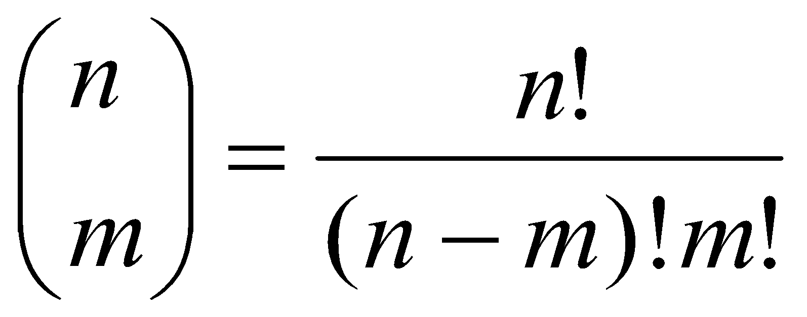
Feature Selection
Goal of search methods
Optimal or sub-optimal selection of m features out of n features still requires evaluation of a large number of possible subsets:
To evaluate set of the selected features this feature selection criterion is used:
J_{feature} (X_{feature})
which is a function of m = n-d features, where d – number of discarded features.
We can alternatively search for “optimal” set of discarded features.
© 2007 Cios / Pedrycz / Swiniarski / Kurgan
37

Slide 38
Feature Selection
Monotonicity of the feature selection criterion:
The best feature subset is found by deleting d indices
z₁, z₂,…,z_{d} from the original n features
and assumes that the maximal criterion value for this subset is
J_{feature}(z₁, z₂,…,z_{d})=β
β-current threshold (as used in B&B tree)
© 2007 Cios / Pedrycz / Swiniarski / Kurgan
38

Slide 39
Feature Selection
Monotonicity of the feature selection criterion:
New feature subset is found by deleting additional r≤d indices: z₁, z₂,…,z_{r}
If
J_{feature}(z₁, z₂,…,z_{r}) ≤ β
then from the monotonicity property we know that
J_{feature}(z₁, z₂,…,z_{r}, z_{r+1},…,z_{d}) ≤ J_{feature}(z₁, z₂,…,z_{r}) ≤ β
this new further reduced feature subset and its successors CANNOT be optimal
© 2007 Cios / Pedrycz / Swiniarski / Kurgan
39

Slide 40
Feature Selection
Branch and Bound Algorithm
Assumes that feature selection criterion is monotonic
Uses a search tree, with the root including all n features
For each tree level, a limited number of sub-trees is generated by deleting one feature from the set of features from the ancestor node
(z_{j} – is index of a discarded feature; each node stores features identified by the sequence of already discarded features)
The largest value of feature index z_{j} on the j^{th} level to be deleted is (m+j)
B&B creates tree with all possible combinations of m-element subsets (desired number of features) from the n-element set but searches only some of them
© 2007 Cios / Pedrycz / Swiniarski / Kurgan
40

Slide 41
Feature Selection
Branch and Bound
Idea: feature selection criterion is evaluated at each node of a search tree
IF the value of the criterion is less than current threshold β
(corresponding to the most recent best subset at a given node)
THEN all its successors will also have a value of the criterion less than β so the corresponding sub-tree can be deleted from the search
© 2007 Cios / Pedrycz / Swiniarski / Kurgan
41

Slide 42
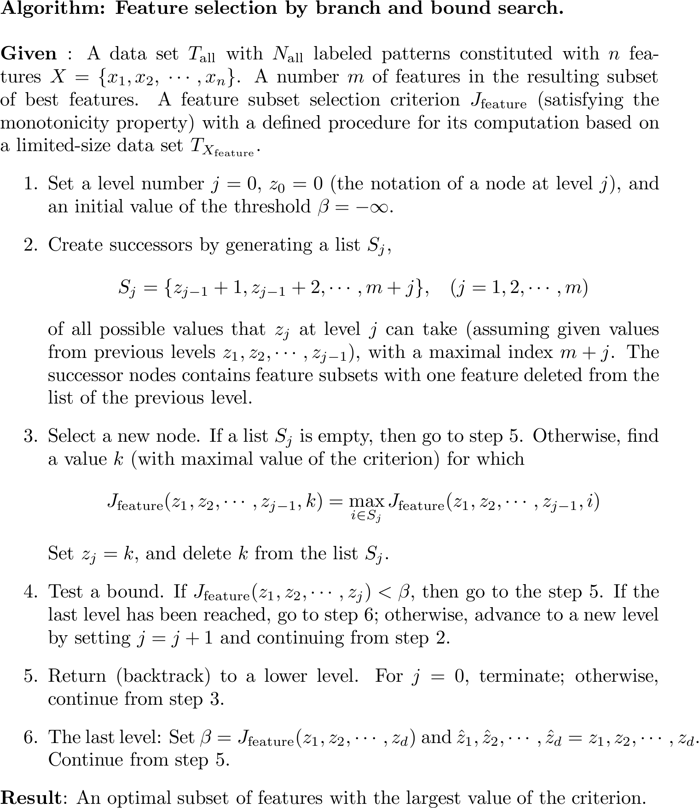
© 2007 Cios / Pedrycz / Swiniarski / Kurgan
42

Slide 43
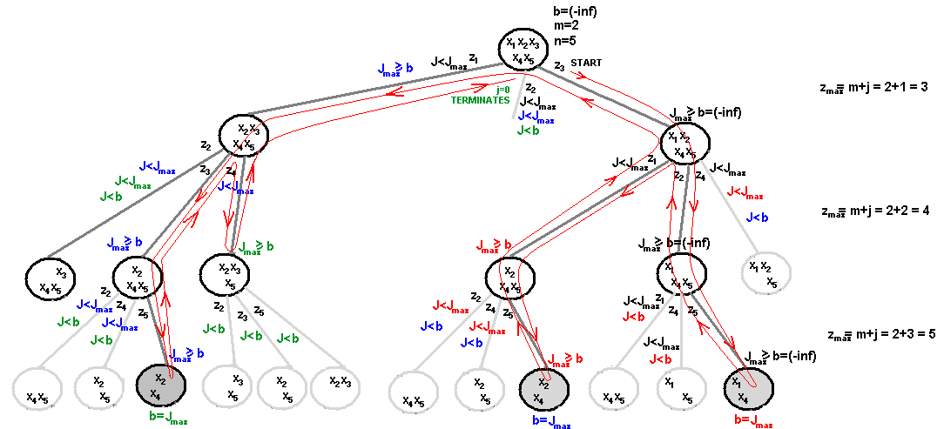
Feature Selection
B&B example: Selection of m=2 feature subset out of n=5 features; feature selection criterion is monotonic
© 2007 Cios / Pedrycz / Swiniarski / Kurgan
43

Slide 44
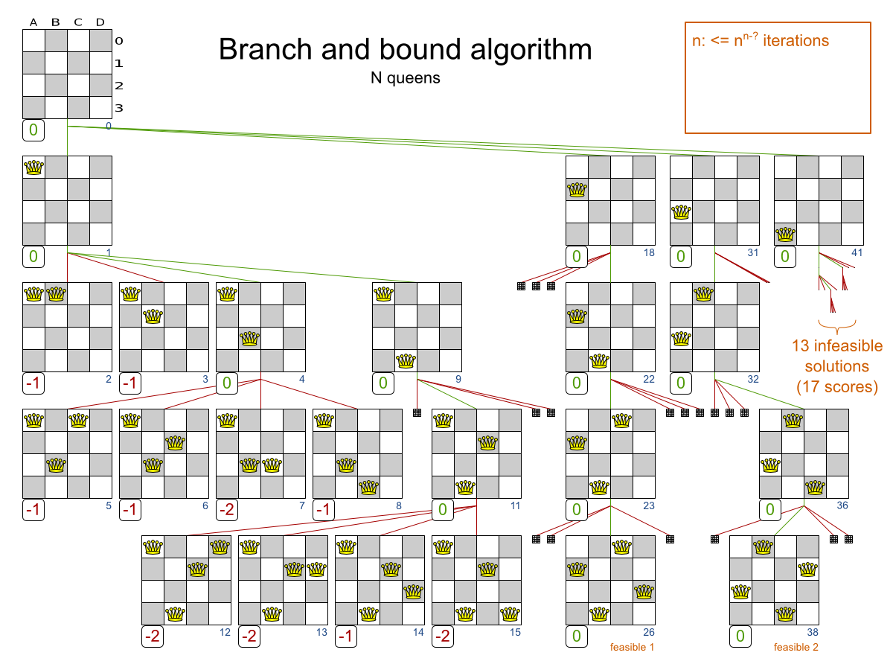
https://memim.com/branch-and-bound.html
© 2007 Cios / Pedrycz / Swiniarski / Kurgan
44

Slide 45
Feature Selection
Individual Feature Ranking
Idea – evaluate predictive power of an individual feature. Then order them, and choose the first m features.
Evaluation of features can be done using closed-loop or open-loop criteria
Assumption:
All features are independent (uncorrelated) and the final criterion is a sum, or product, of the criteria used for each feature independently.
© 2007 Cios / Pedrycz / Swiniarski / Kurgan
45

Slide 46
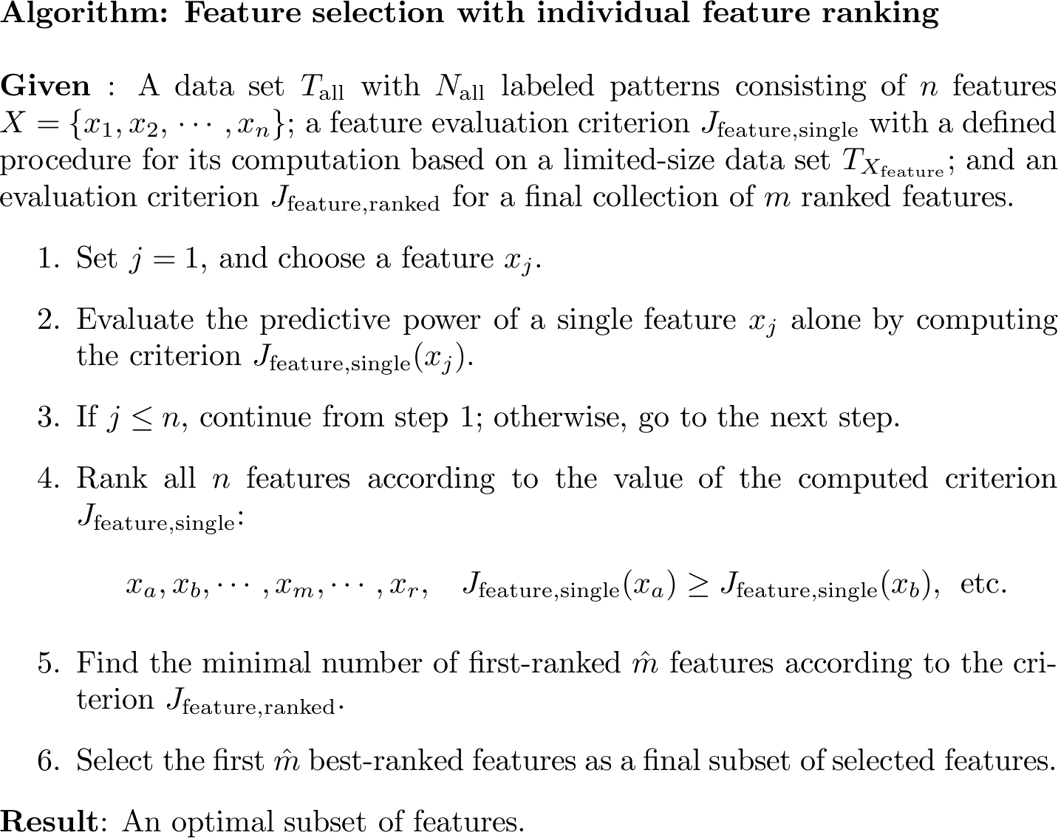
© 2007 Cios / Pedrycz / Swiniarski / Kurgan
46

Slide 47
Feature Selection
Sequential Forward Feature Selection
Is sub-optimal as not all feature subsets are examined but at a highly reduced computational cost
In each step of the search one “best” feature is added to the sub-optimal feature subset
During the first iteration individual feature selection criterion is evaluated and feature x* is selected
During the second iteration feature selection criterion is evaluated for all pairs (x*,x_{n}) and best 2-feature subset is selected, etc.
© 2007 Cios / Pedrycz / Swiniarski / Kurgan
47

Slide 48
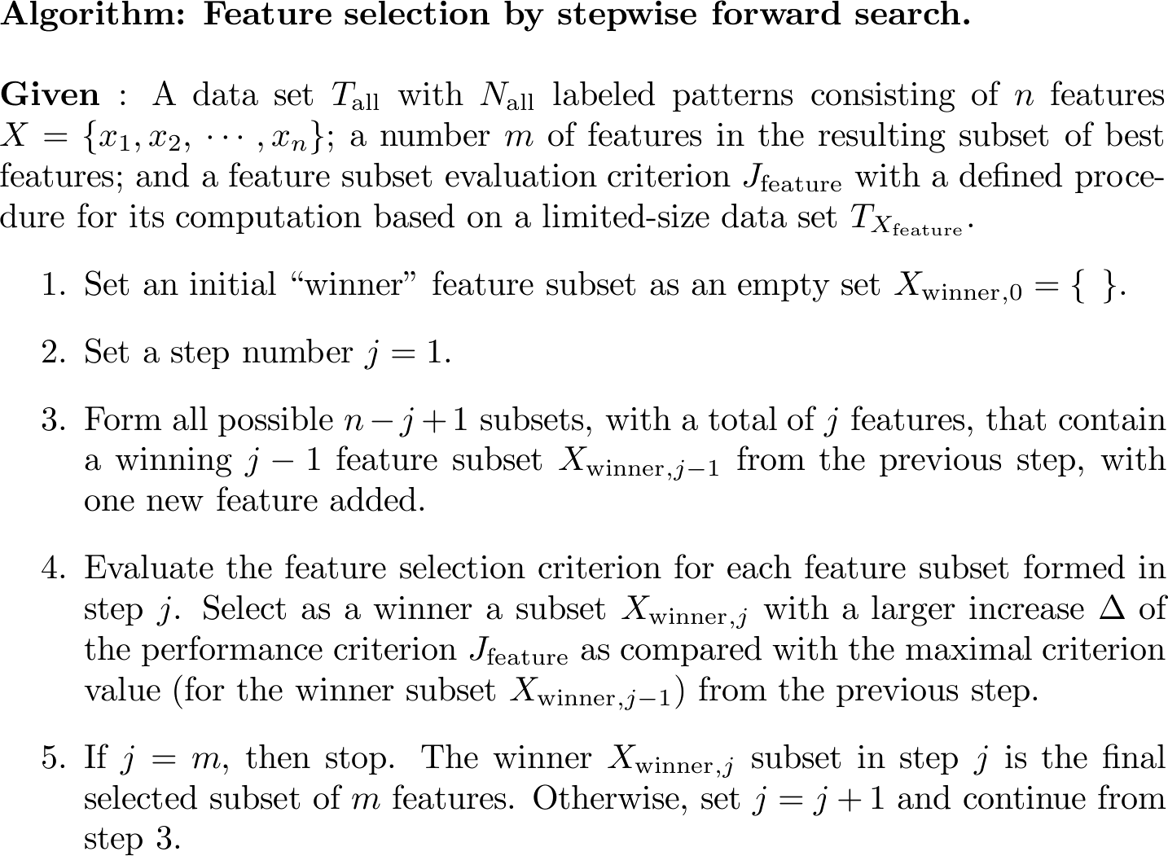
© 2007 Cios / Pedrycz / Swiniarski / Kurgan
48

Slide 49
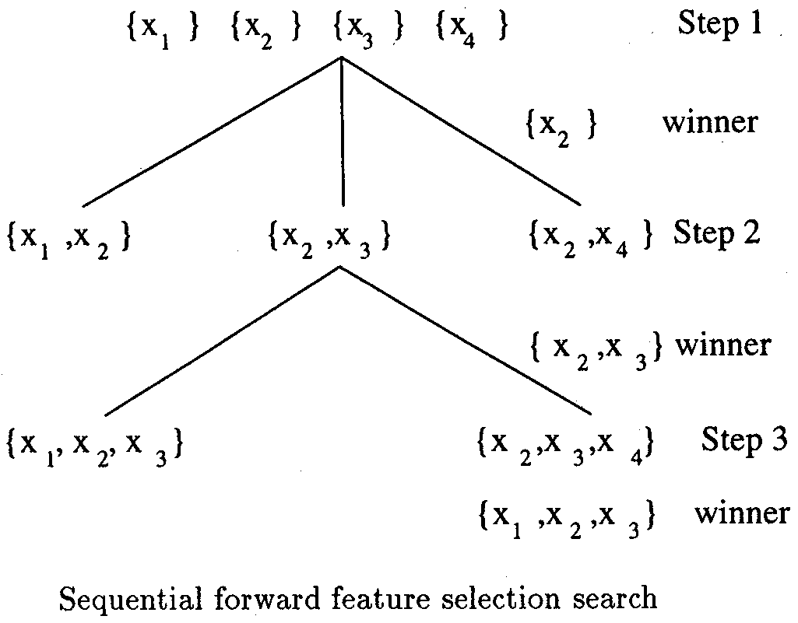
Feature Selection
Sequential Forward Feature Selection
Example:
selection of m=3
out of n=4 features
© 2007 Cios / Pedrycz / Swiniarski / Kurgan
49

Slide 50
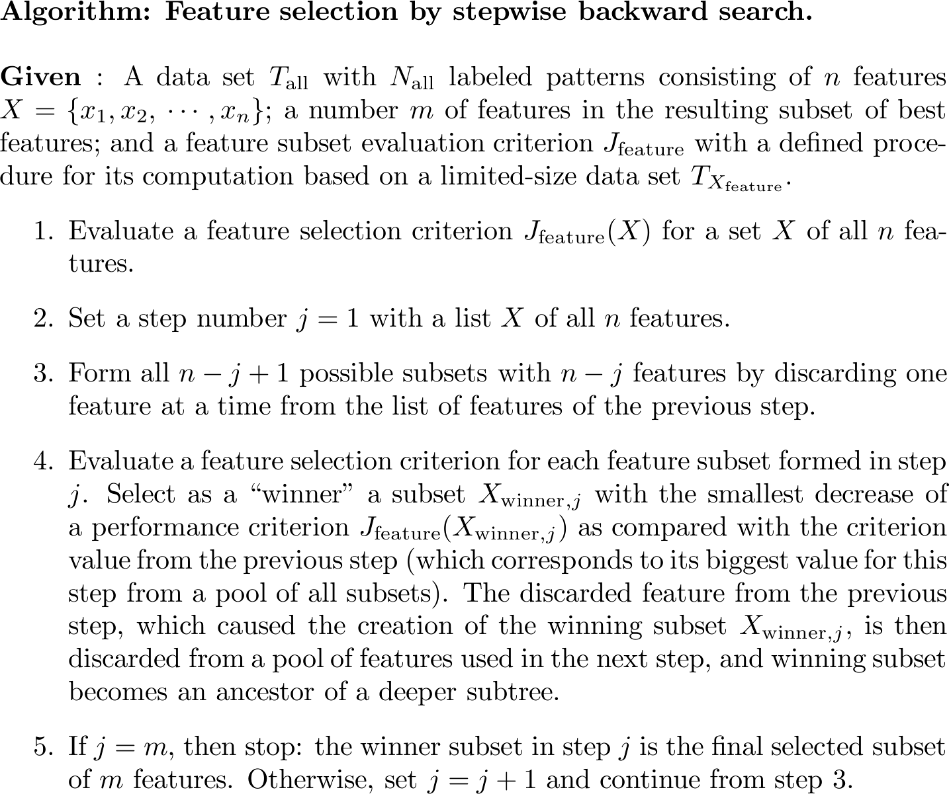
© 2007 Cios / Pedrycz / Swiniarski / Kurgan
50

Slide 51
Feature Selection
Sequential backward feature selection
Find m = 2 feature subset from n = 4 features using feature selection criterion J_{feature}
X = { 1, 2, 3, 4 }
[1,2,3] [2,3,4] [1,3,4] [1,2,4] step 1
J[2,3,4] = winner
[2,3] [2,4] [3,4]
step 2
The final optimal subset is {3,4} . J[3,4]= winner
51

Slide 52
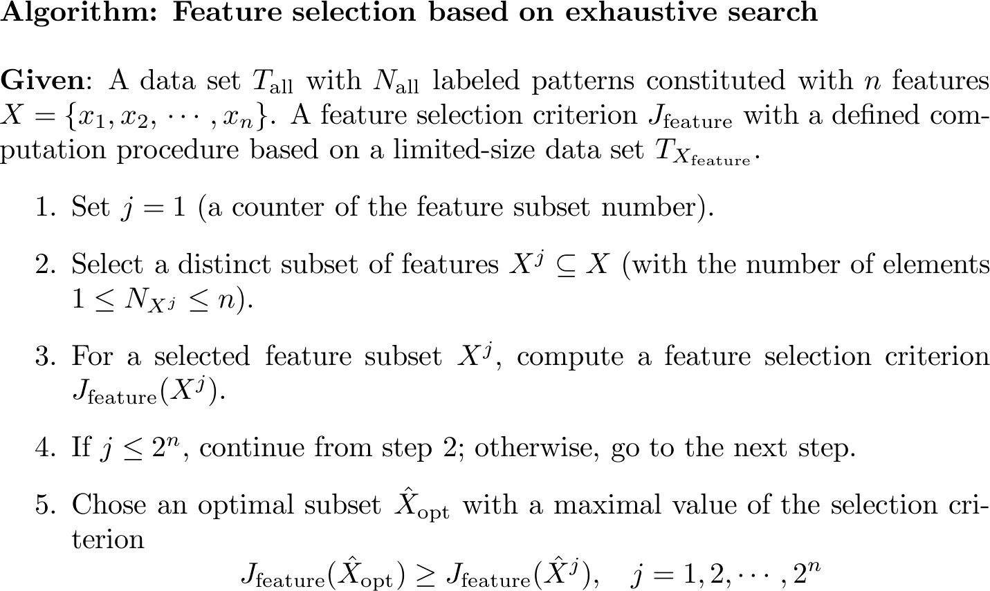
© 2007 Cios / Pedrycz / Swiniarski / Kurgan
52

Slide 53
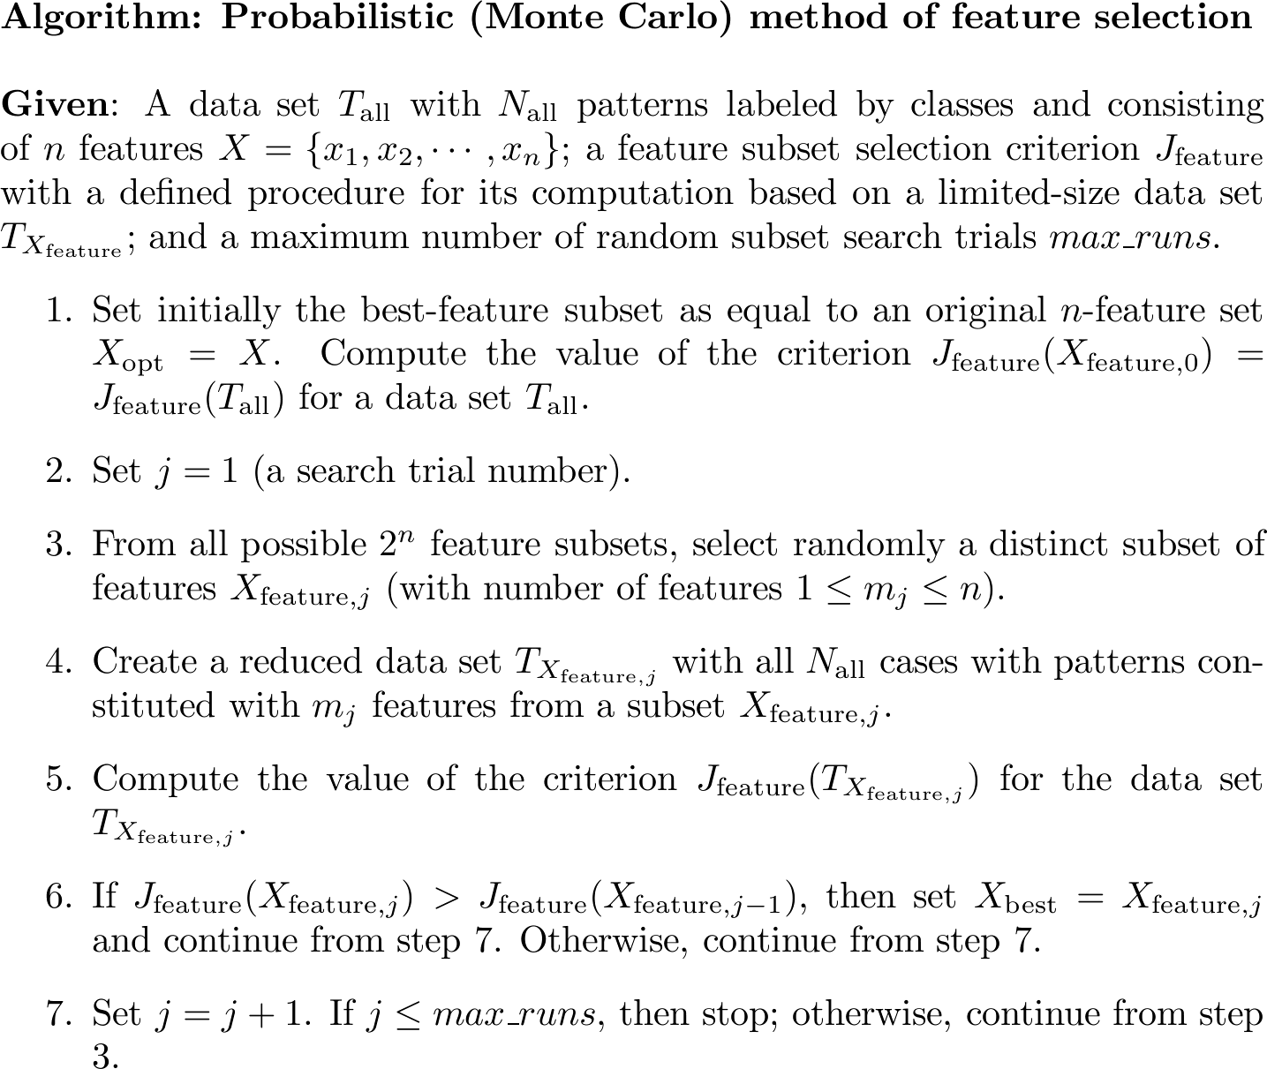
© 2007 Cios / Pedrycz / Swiniarski / Kurgan
53

Slide 54
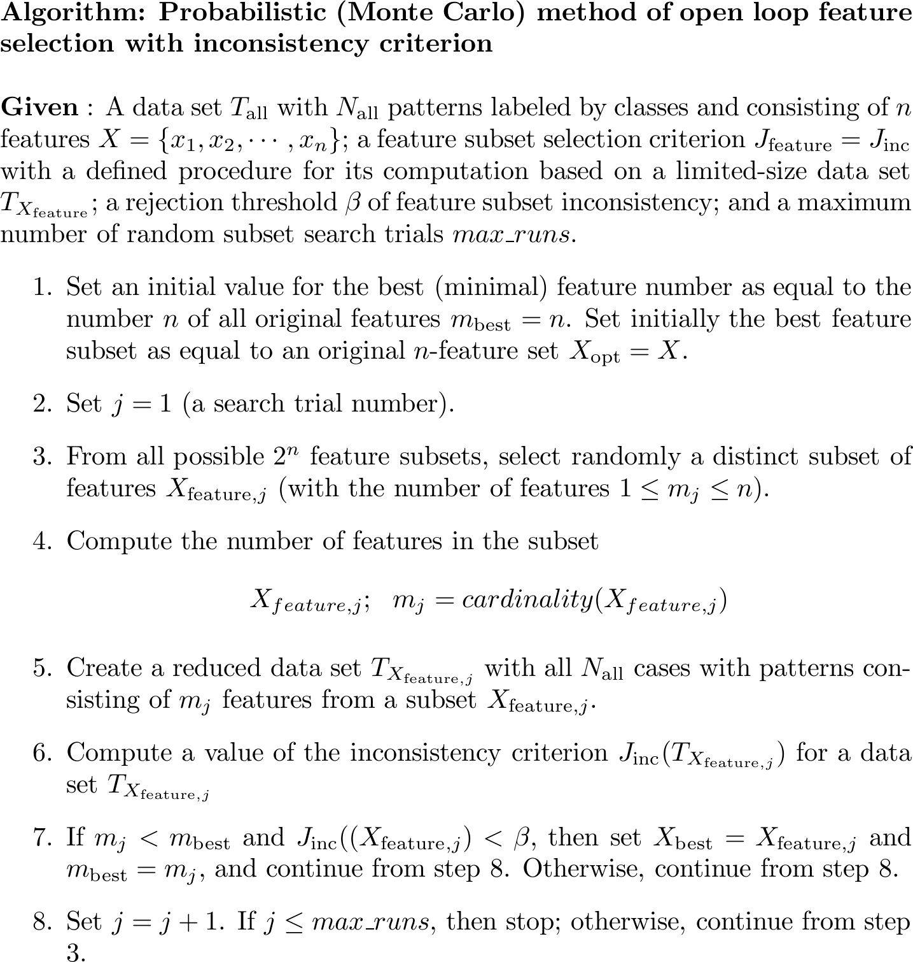
© 2007 Cios / Pedrycz / Swiniarski / Kurgan
54

Slide 55
Feature Selection
Other Methods
SOM (Kohonen’s neural network)
Feature selection via Fuzzy C-Means clustering
…
© 2007 Cios / Pedrycz / Swiniarski / Kurgan
55
Notes:
SOM Sel

Slide 56
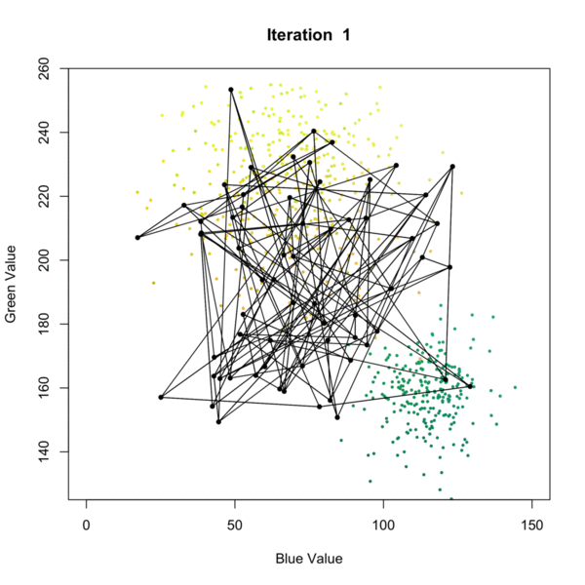
Self Organizing Map (SOM) Example

Slide 57
References
Cios, K.J., Pedrycz, W., and Swiniarski, R. 1998. Data Mining Methods for Knowledge Discovery. Kluwer
Duda, R.O., Hart, P.E., and Stork, D.G. 2001. Pattern Classification. Wiley
Han, J., and Kamber, M. 2006. Data Mining: Concepts and Techniques. Morgan Kaufmann
Kecman, V. 2001. Learning and Soft Computing. MIT Press
"Branch-And-Bound". Memim.Com, 2019, https://memim.com/branch-and-bound.html.
Kaushik, Saurav, and Saurav. “Feature Selection Methods with Example (Variable Selection Methods).” Analytics Vidhya, 12 Mar. 2019, www.analyticsvidhya.com/blog/2016/12/introduction-to-feature-selection-methods-with-an-example-or-how-to-select-the-right-variables/.
Khan, Asad, et al. “Identification of MicroRNA Precursors Using Reduced and Hybrid Features.” Molecular BioSystems, The Royal Society of Chemistry, 15 June 2017, pubs.rsc.org/en/content/articlelanding/2017/mb/c7mb00115k.
"Self-Organizing Maps Tutorial". Algobeans, 2019, https://algobeans.com/2017/11/02/self-organizing-map/.
“Trunk's Example of the Peaking Phenomenon.” Pattern Recognition Tools, 28 Nov. 2016, 37steps.com/2448/trunks-example/.
© 2007 Cios / Pedrycz / Swiniarski / Kurgan
57

